Slide 1




Good Morning
Good Morning
=

Slide 2

Good Morning
datamining
Calculus

Slide 3
Shourav Deb
(**** Std ID ****)
What is datamining ?
What is calculus ?
What is the use of calculus in datamining ?

Slide 4
Application of calculus in data mining
Assigned by : Nazneen Sultana
Presented By
Shourav Deb (**** Std ID ****).
Mahbub Hasan (**** Std ID ****).
Md Saikat Islam Shuvo (**** Std ID ****).

Slide 5
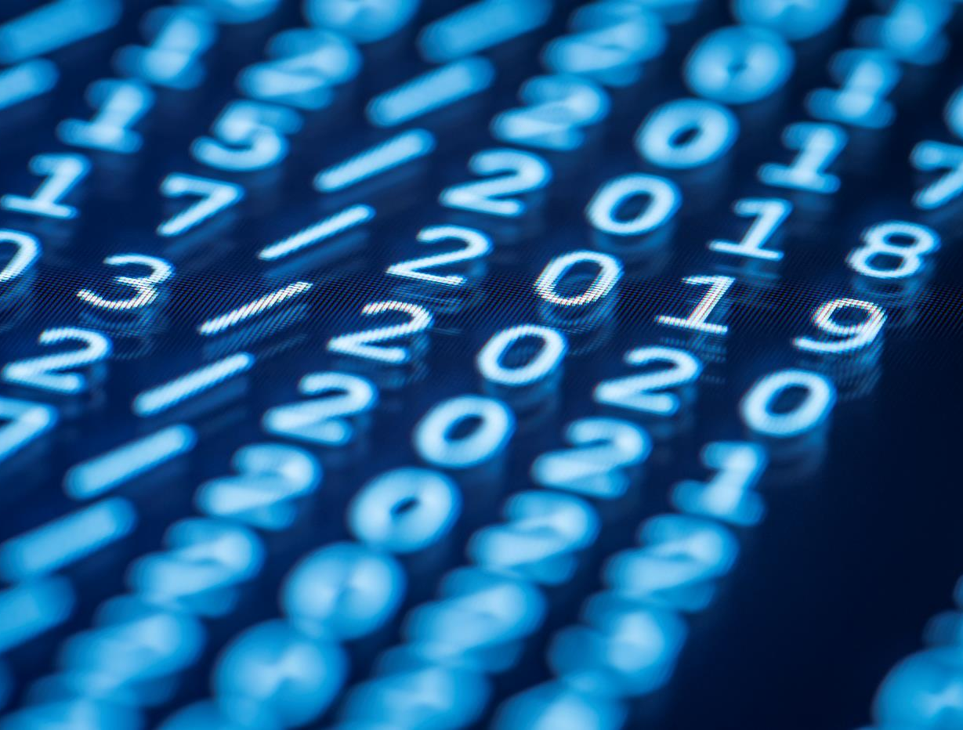
Datamining

Slide 6





Tech Requirements
Network
Satellite
Link

Slide 7

Tech Requirements
Network
Satellite
Link

Slide 8


Tech Requirements
Network
Satellite
Link

Slide 9


Tech Requirements
Network
Satellite
Link

Slide 10



the room after redecoration
Chunk of data
List of Necessary stuff
data mining of necessary data

Slide 11
Datamining
Datamining
Data mining is the process of analyzing a large batch of information to pull out the necessary data or information.

Slide 12

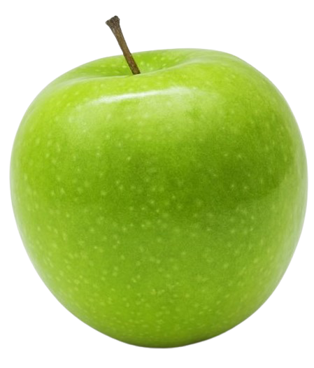
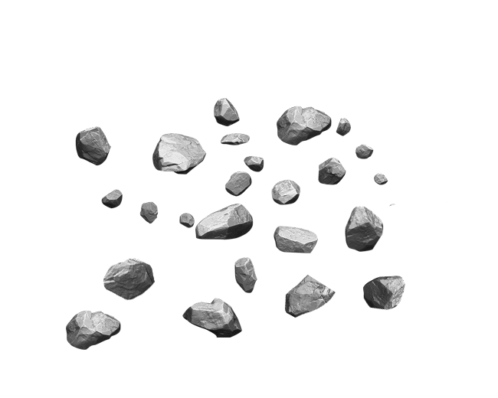
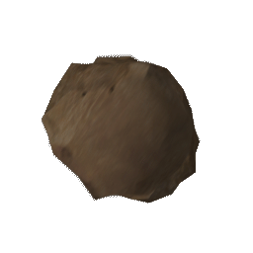
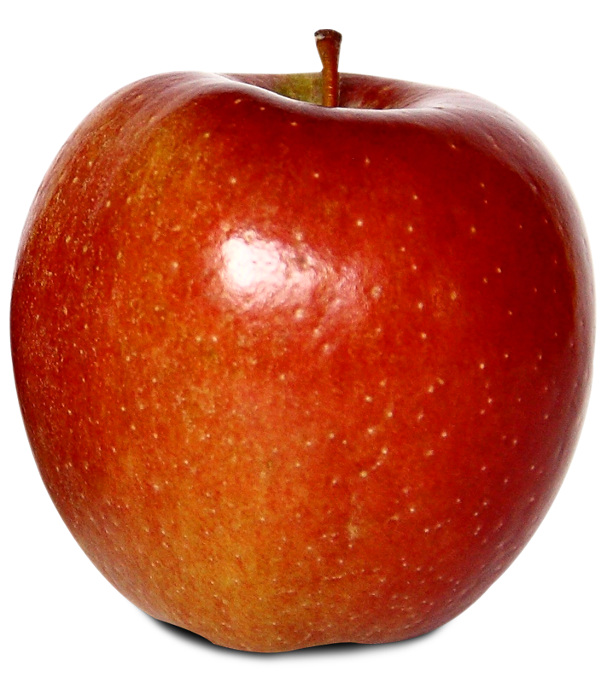

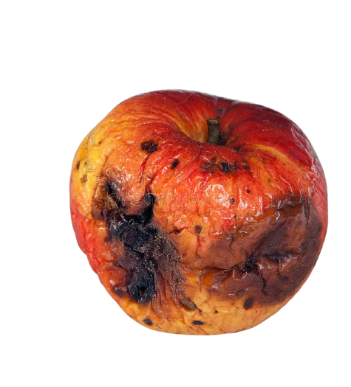
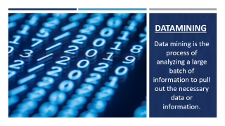
Digital Communications
Cloud
Local
Hybrid
Calculus
=
=

Slide 13
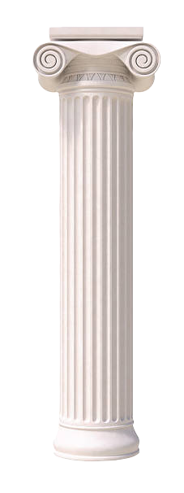
Digital Communications
Calculus
Cloud
Local
Hybrid
Differentiation
Integration

Slide 14
What is Differential Calculus & Integral Calculus?

Slide 15
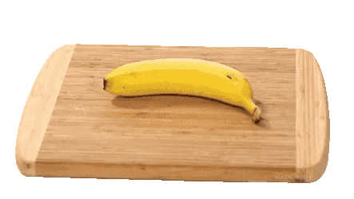
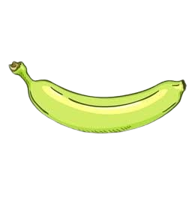

Differential Calculus:

Slide 16

Integral Calculus :

Slide 17
The Application of Calculus in Datamining

Slide 18
Mahbub Hasan
(**** Std ID ****)

Slide 19
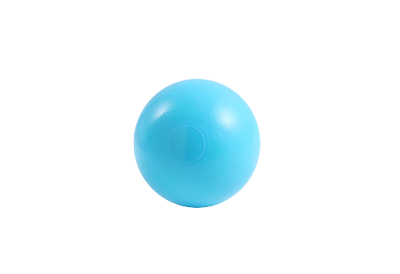
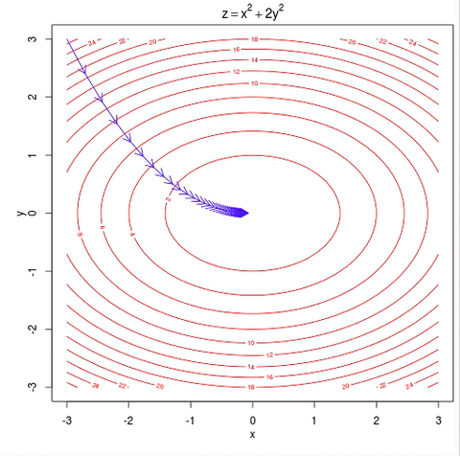
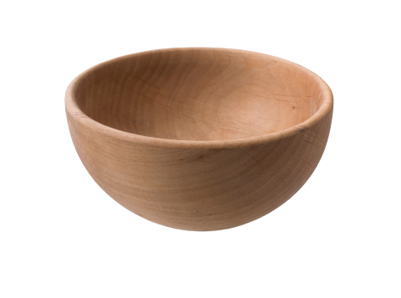
Gradient Descent

Slide 20



Math: 83
Physics: 78
Chemistry: 72
Biology: 66
English: 59
Engineer
Math:78
Physics: 56
Chemistry: 65
Biology: 83
English: 66
Doctor
Math:
Physics:
Chemistry:
Biology:
English:
!

Slide 21
Profession
Math:78
Physics: 56
Chemistry: 65
Biology: 83
English: 66
Gradient

Slide 22

Marks
Doctor/Engineer
Data mining
Calculus
Analyze Data
Collect
Anlyze

Slide 23
Saikat Islam Shuvo
(**** Std ID ****)

Slide 24
Differential Calculus
Gradient descent
Integral Calculus

Slide 25
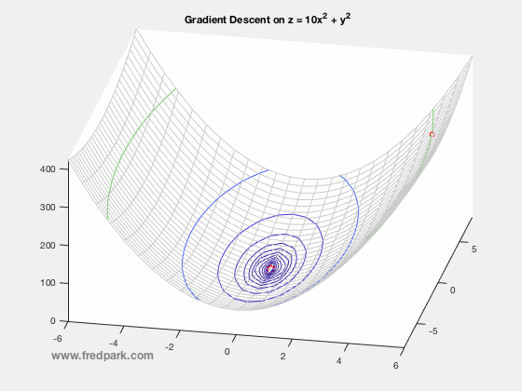
Math:
Physics:
Chemistry:
Biology:
English:
!
Differential Calculus

Slide 26
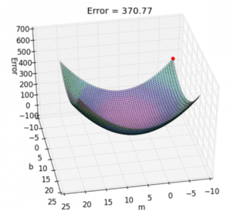
Math:
Physics:
Chemistry:
Biology:
English:
!
Intregal Calculus

Slide 27
Tech Requirements
Network
Satellite
Link

Slide 28

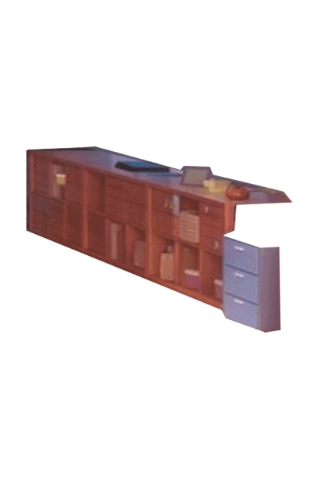


=
Differential Calculus
Intregal Calculus

Slide 29
Multivariate statistical analytics. (using vector calculus)
Continuous statistical distributions

Slide 30
Recap:
Data mining
Calculus
Meet Simran
Application of calculus in datamining

Slide 31
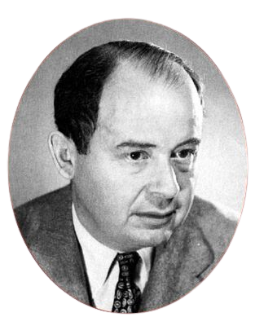
“ The calculus was the first achievement of modern mathematics and it is difficult to overestimate its importance. ”
- Sir John von Neumann

Slide 32
Priority Level
Little
Medium
Much
Thank you for staying that long

